Slide 1
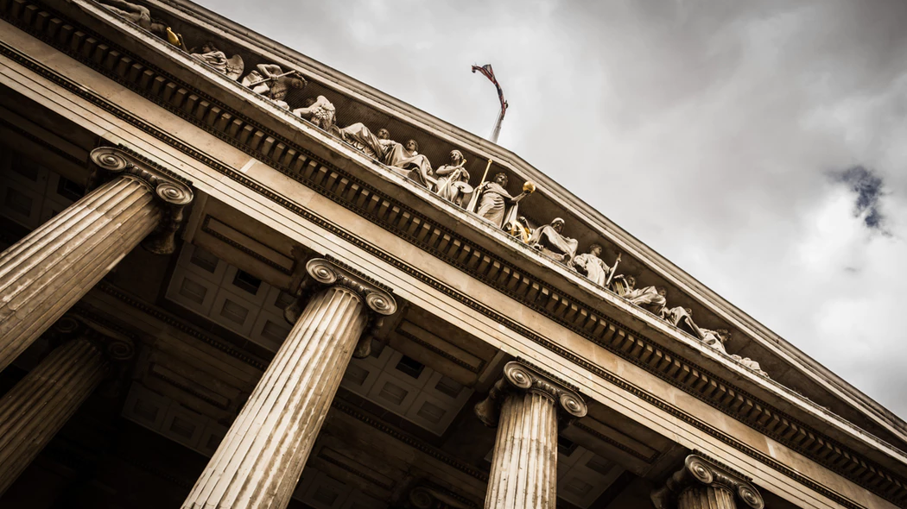
The Island Challenge
#3
Why is government necessary?

Slide 2
Turn & Talk
Why do we have laws?
What would our world look like without laws?
Notes:
The Purge, traffic laws, drinking and driving. THE SAFETY OF US AND OTHERS!

Slide 3
Fill in the web with ideas or words that you associate with 'government'
Government

Slide 4
The Government
Makes and changes laws
Decides how much people should pay in taxes and how that money should be spent
Can control access to education and health care
Decides if people have the right to elect those in power

Slide 5
https://www.kidzworld.com/article/17990-top-10-strange-laws

Slide 6
The Island Challenge
Imagine we are the survivors of a plane crash. We are on a deserted, tropical island somewhere in the South Pacific. A week has passed. We have made signs, signal fires, and attempted to contact the outside world without success. There has been no sign of help or rescue on the way. It’s time to move to Plan B.

Slide 7
The Island Challenge
Slowly, we realize we might be stranded on this island for a long time. We decide we need to try and organize. Here is what we know:
Location:
Tropical Region
Rains often
Hot and Humid
Vegetation
Beach area
Jungle and hills
Seen boars, fish, fruit trees
Vegetation:
*Beach area
*Jungle and hills
*Seen boars, fish, fruit trees
Supplies:
Salvaged first aid kits, bottled water, and dinner trays from wreck
Some suitcases washing up on shore

Slide 8
The Island Challenge
When we realized we were going to need to live together peacefully to survive, a list of important issues to discuss was created.
Go through each of the criteria and write your ideas and suggestions outlining what you believe would be best.

Slide 9
JOBS: list at least 5 jobs that there needs to be. How will you decide who will do what job?
LAWS: should there be laws. What should they be? Create at least 5 laws.
LEADER: Is there a leader(s)? How will you decide who is in charge?
PROPERTY: Who owns what? Will you have ‘houses’ or land? Share everything? Will you have a place to sleep every night that is YOURS, etc. ?

Slide 10
The Island Challenge
Each survivor has thought about what would be best to keep order and enjoy life on this island.
As a class, listen to one another’s suggestions.
Decide on a final version of the expectations and laws that we will all abide by and accept.
I will not be involved in the process. In 10 minutes I will ask you to tell me the group’s decisions on the main points of the outline:
You have 10 minutes to complete the following decisions:
5 Jobs
5 laws
Leader
Property
By the end of 10 minutes I expect all of the above to be written on the chart paper as your classroom decree.

Slide 11
1st Period Observations
Maggie grabbed a marker first thing
Everyone crowded into small groups: 4-5 around the room
Jamie’s small group takes charge & begins to write on the paper
The boys group disagrees
Some survivors never said anything to any one
About 4 minutes in, everyone crowds the front
Boys aren’t really involved
No one has ever voted
Everyone seems to take a turn writing something down
When you were finished writing your contribution you went back to your corner & didn’t see what else had been written

Slide 12
6th Period Observations
Julian took control first thing
The loudest people had a say
Julian gets mildly frustrated 1-2 times dues to noise level and chaos
Voting was used: choose side and 1 time raise hands
Some survivors never said anything
Sela began to interject & lead with Julian
Hannah takes over writing the rules
Many people by minute 8 are not participating & having off topic conversations with friends
Some survivors never voted

Slide 13
5th Period Observations
Ross takes a marker first thing
Everyone spreads out but Ross & friends are able to corral almost everyone to the front corner of the room
Ross decides that if you want to speak you should raise your hand
It works relatively well
Everyone agrees by saying ‘Yes”
Jaxon attempts to help lead with Ross.
Some survivors never say anything
A small groups asks several times if they can form their own group with a minute and a half left Ms. M says go for it!

Slide 14
Autocracy
Government where one person has total power

Slide 15
Democracy
Government where the people have the power

Slide 16
Table of Contents
The Island Challenge 2 (#4)

Slide 17
Think About It
1. How did you feel during the course of the activity? Why?
2. Give an example of when a majority of the class agreed on a decision.
3. Give an example of when the class disagreed on a topic.
4. Give an example when one person made the decision or tried to make the decision for the whole class.
5. What are some advantages and disadvantages to each of these decision-making strategies?
Notes:
Understand the difficulties in forming a government that EVERYONE agrees on.
There's no way to make everyone happy.

Slide 18
The Challenge of Forming a Government- Answer each of the following question based on the island lesson.
1. Based on this experience, do you think that people can be trusted to govern themselves? Why or why not?
2. What are the reasons citizens would want to limit the power of their government?
3. If you were a citizen of an unlimited government, describe your freedoms.
4. If you were a citizen of a limited government, describe your freedoms.

Slide 19
1.
2. abuse of power, not acting in best interest of people, uneven distribution of wealth and resources, etc.
3. Would not have freedoms- government and ruler have total control, can be killed or jailed for not following laws
4. Ability to vote, freedom of speech, ability to protest and petition government, freedom of press, etc.

Slide 20
Number 1-10
Read each of the scenarios. Decide whether each decision was made in an autocratic or democratic way. Write ‘A’ for autocratic & ‘D’ for democratic.

Slide 21
Question 1:
A teacher decides there will be a test on Friday and writes it on the board.

Slide 22
Question 2:
A group of friends decide on which movie to see by discussing three possibilities and voting on which one they want to see.

Slide 23
Question 3:
A manager of a fast food restaurant decides to give workers a 50¢ per hour raise.

Slide 24
Question 4:
A mother listens to her children’s reasons for buying the new video game and then decides not to buy it because it is not appropriate for their little sister to see.

Slide 25
Question 5:
A mother, father, and their three children all choose to go to the beach for a vacation, even though the oldest wanted to go camping in the mountains.

Slide 26
Question 6:
Ryan planned a surprise date for his girlfriend Dana. He took her to a dinner at her favorite restaurant and then to see the brand new Marvel movie.

Slide 27
Question 7:
The mayor, elected by citizens of the town, changed an old law.

Slide 28
Question 8:
The citizens voted in favor of a city tax measure that would increase funding for libraries.

Slide 29
Question 9:
The biggest kid in sixth grade choses the teams for kickball at recess every day.

Slide 30
Question 10:
Each member of the hockey team wrote a player’s name on a sheet of paper for their Most Valuable Player selection.

Slide 31
Answers:
1. A
2. D
3. A
4. A
5. D
6. A
7. D
8. D
9. A
10. D

