Slide 1
Geography Scavenger Hunt (#2)

Slide 2
Let’s practice time zones

Slide 3
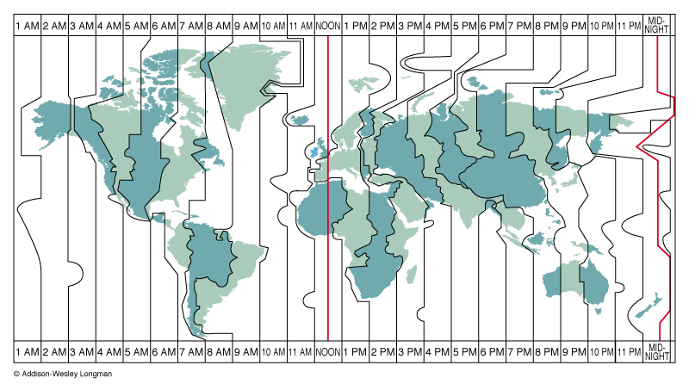
Time Zones Explained
https://www.youtube.com/watch?v=r9FpineKvQU&t=58s Start- 2:40

Slide 4
Time zones
https://www.timeanddate.com/time/map/

Slide 5
See below for which map to use:
Global Time: https://tinyurl.com/p6ep6ys Textbook Page #A17 | World Geography: https://tinyurl.com/yd58d8ws Textbook page #A5
United States Geography: https://tinyurl.com/y9gyb76p Textbook page #A21 | World Populations: https://tinyurl.com/k2g5rt7 See me for a hard copy

