Slide 1
What are the Social Studies? (#1)

Slide 2
Peoples of the World
Knowledge of other cultures leads to understanding which leads to getting along with other cultures and can reduce problems.

Slide 3
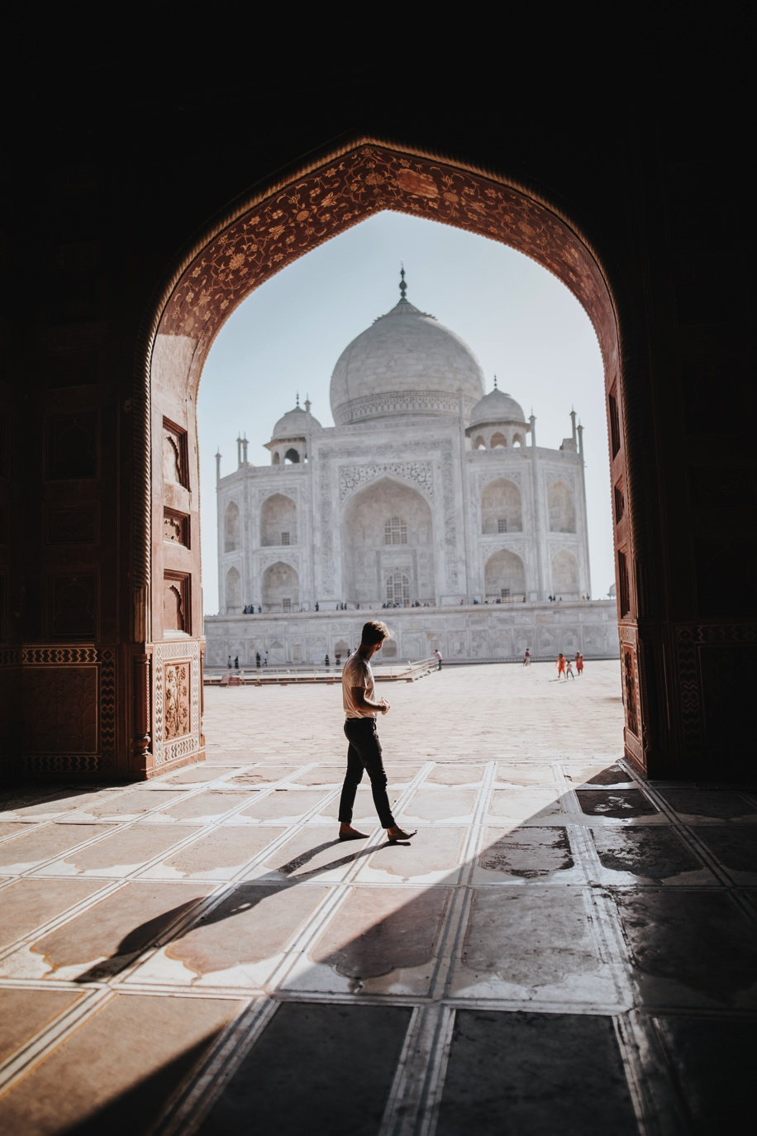
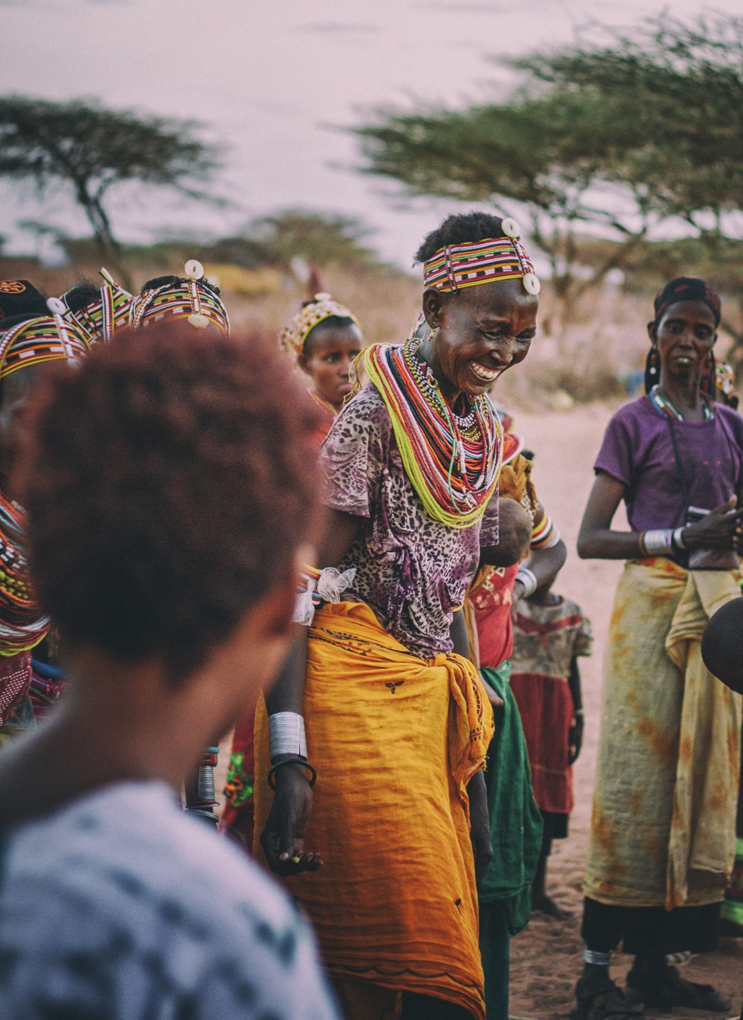
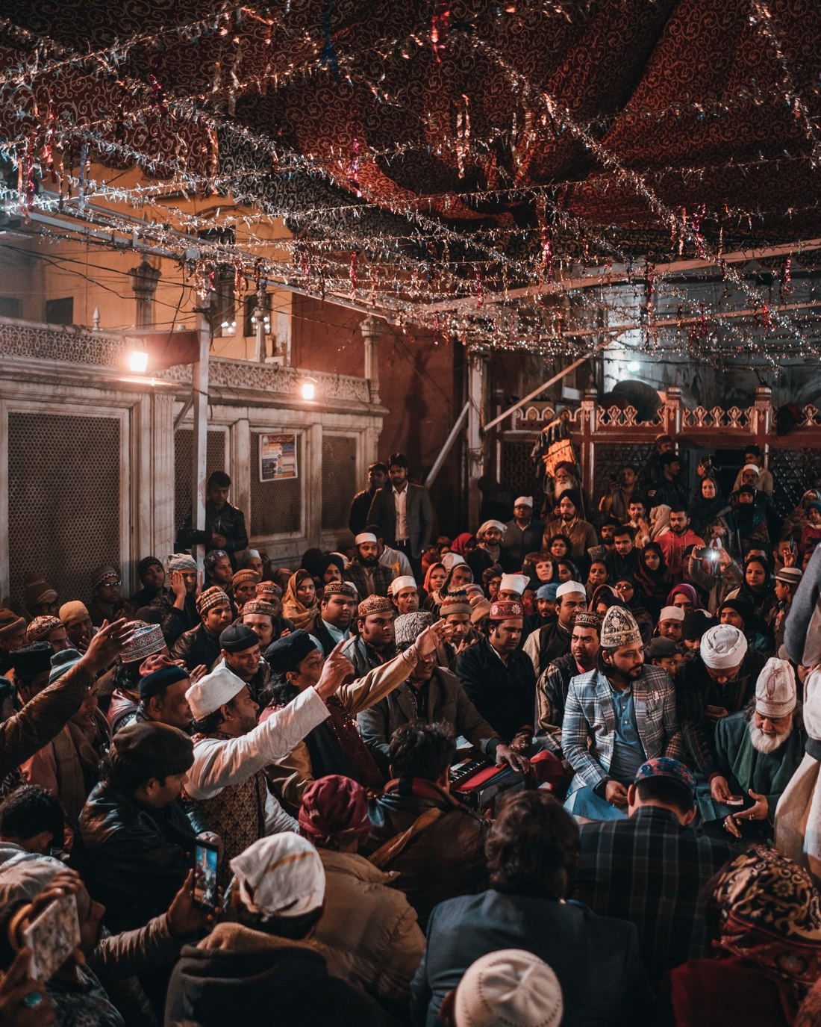

Slide 4
The five fields of social studies gives us this knowledge
Geography
History
Economics
Government
Culture

Slide 5
Geography
Geography is the study of people, places, and the environment
There are five themes of geography
Place – considers an area of distinguishing characteristics
Location – tells where a place is
Region – several countries in an area make up a region
Movement – migration of people, animals, and plants
Human-environment interaction – show how people are changed by their environment and vice versa

Slide 6
Government (civics)
Those within a society who make laws, carry out laws, and settle disputes
The type of government is based on those who have the power

Slide 7
Do you know definitions to any of these words?
Write short definitions or examples for as many as you can on your post-it.
Democracy
Autocracy
Dictatorship
Theocracy
Monarchy
Oligarchy

Slide 8
Limited Governments- rulers must follow the laws & the people have a say
Democracy- everyone has a say
Parliamentary & Presidential

Slide 9
Unlimited Governments- the rulers decide without the people
Autocracy- one ruler
Totalitarianism: total control
Dictatorship- military leader, takes control by force
Theocracy- rule by religious leader
Monarchy- king or queen
Oligarchy- rule by a small group of elites

Slide 10
Economics
Economics – The study of the way people manage their resources by producing and exchanging goods and services
Peoples’ wants and desires for goods and services are almost unlimited
The amount of goods and services are limited
This means that goods and services are scarce (scarcity)

Slide 11
Economists identify 4 types of resources that are available:
Land: the natural resources used
Labor: the human factor – those who do the work for a business. workers
Capital: the equipment that is used to do work
Entrepreneurship: those who start a business and take economic risks

Slide 12
All economies must answer three questions
What to produce?
How to produce?
For whom to produce?

Slide 13
There are three types of economies
Command
Market
Mixed
Traditional

Slide 14
In a command (controlled) economy the government decides all three
In a market (capitalist) economy producers and consumers make all decisions
In a traditional economy, tradition and customs make all decisions

Slide 15
History
History is the record of the past
People and events in the past made the world what it is today
Historians search primary sources

Slide 16
Choose one quote & respond to it on the back of your paper in 1 sentence.
“Those who cannot learn from history are doomed to repeat it.” -George Saytayana
“History is a guide to navigation in perilous times. History is who we are and why we are the way we are.” -David McCullough
Respond: examples, resonations, agree, disagree.

Slide 17
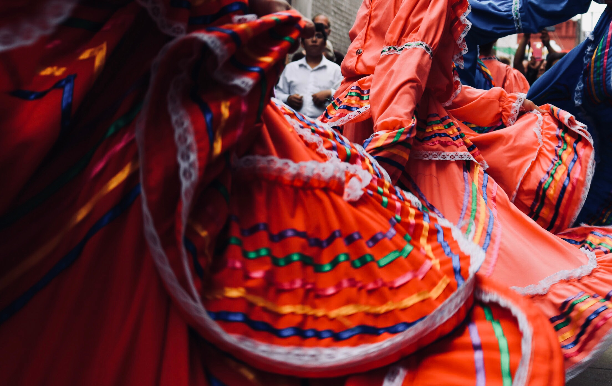
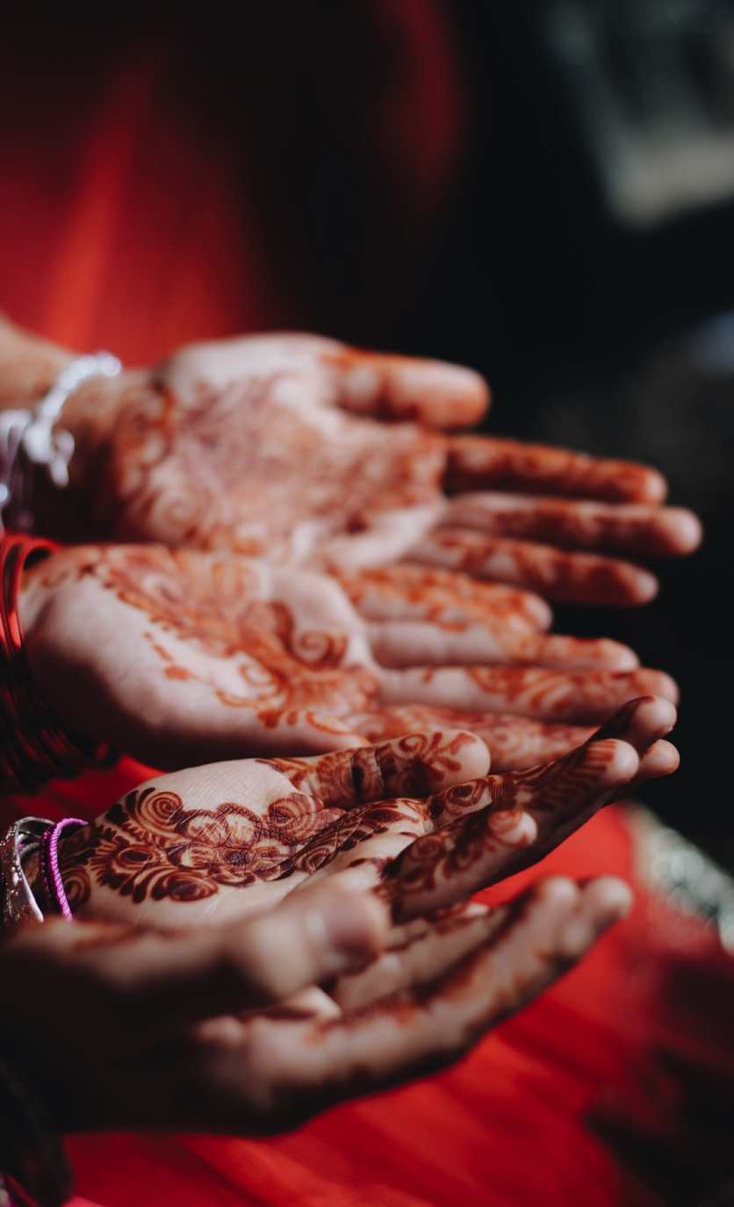

Slide 18
Culture
Beliefs, customs, laws, art, language, and way of living that a group of people share

Slide 19
Vocabulary
This will go on the back of #1

Slide 20
Geography Dictionary
Literacy rate
Civil war
Famine
Standard of living
Natural resources
Petroleum
Overpopulation
Water (importance of)

Slide 21
Literacy Rate
The number of people in a country who can read and write, that are over the age of 15.

Slide 22
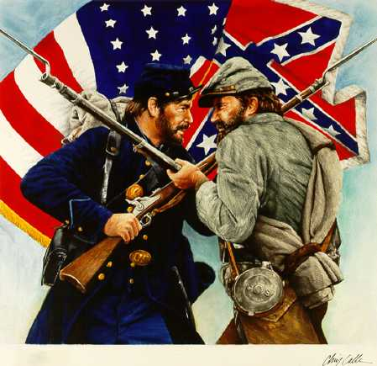
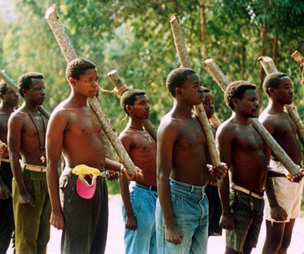
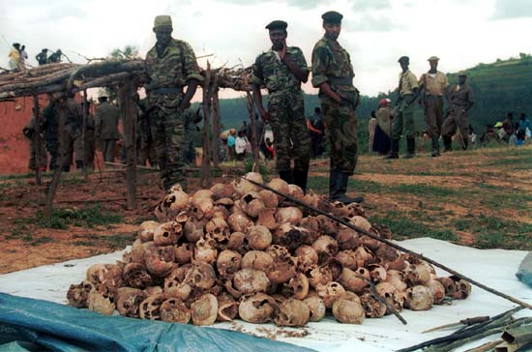
Civil War
A war between two groups from within the same country.

Slide 23
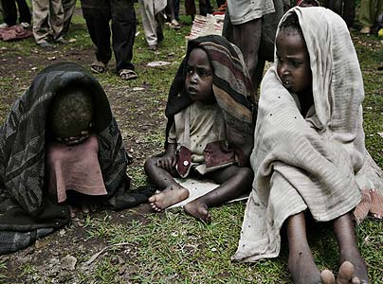
Famine
A shortage of food resulting from war or natural disaster.

Slide 24
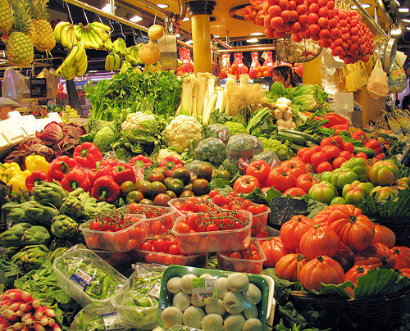
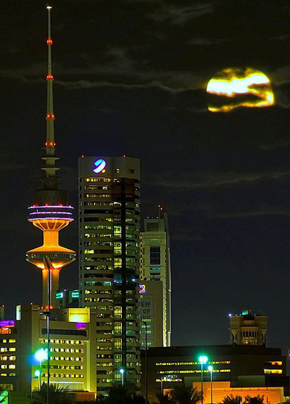
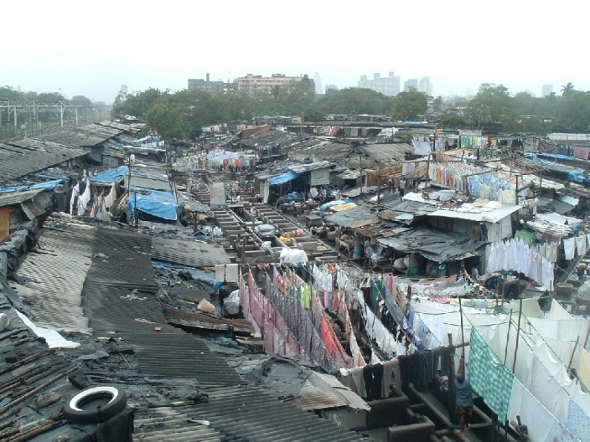
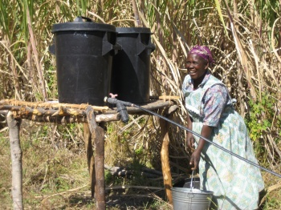
Standard of Living
Quality of life the people in a nation or region

Slide 25
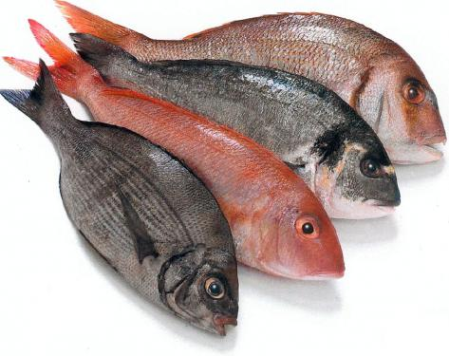
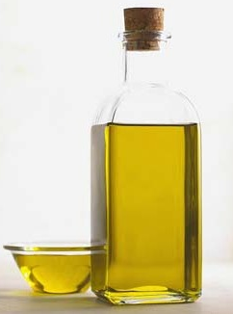
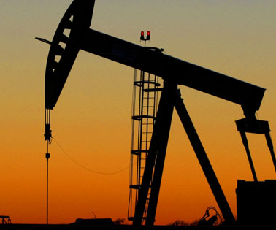
Natural Resources
Things people can use found in nature
Oil, Natural Gas, Coal, Timber.

Slide 26
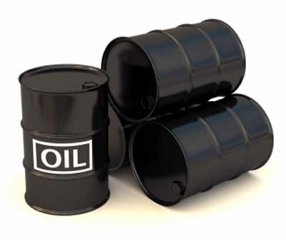
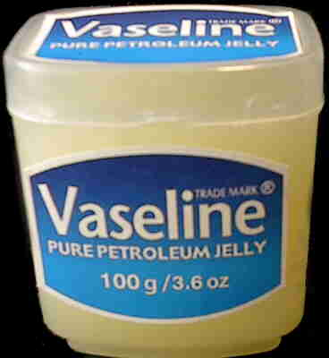
Petroleum
Same as oil, just a different word.
Also refers to oil based products

Slide 27
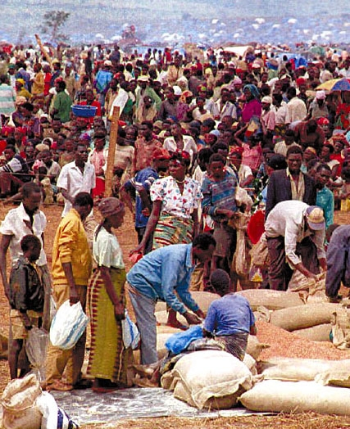
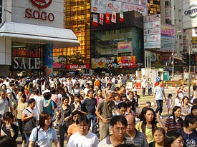
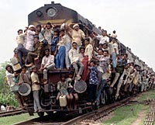
Overpopulation
A situation where too many people existing in one area for how much land is available & resources there are

Slide 28
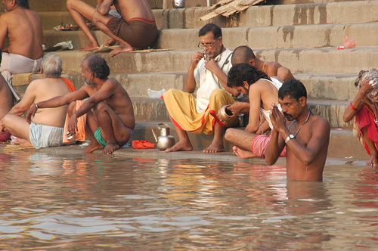
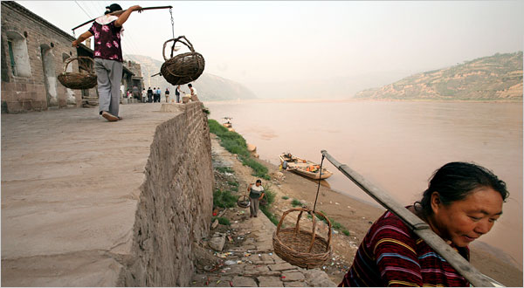
Water (Importance of)
Transportation, irrigation, food, drinking water, import/exports, sewage.
Yellow River
(Huang He)
Maldives
Ganges River

